Slide 1
How to Teach Computers to Recognize Things S4: Dataset Preparation: Building our Real-life “Textbooks”
Dr. Du Pengfei
CPPS/DMD
20 April 2023

Slide 2

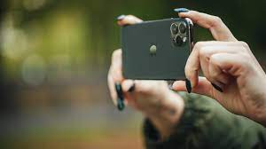
Agenda
First half: New Round of Data Labelling Close to Reallife
Second half: Meet out student: AI computer

Slide 3
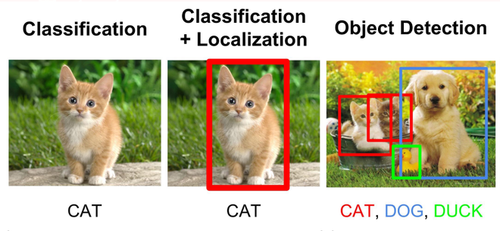
Classification VS Detection
Output: Scripts ONLY
Output: Scripts + Annotation

Slide 4
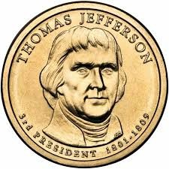
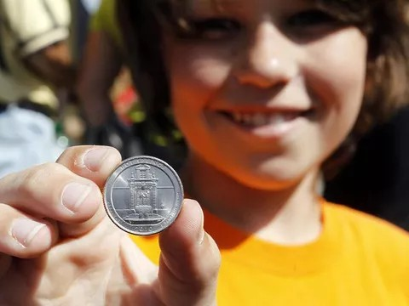
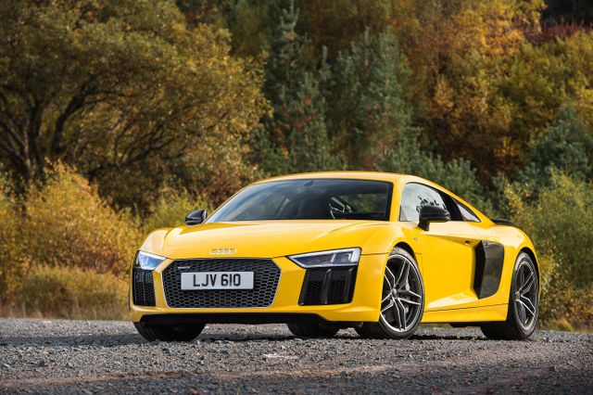

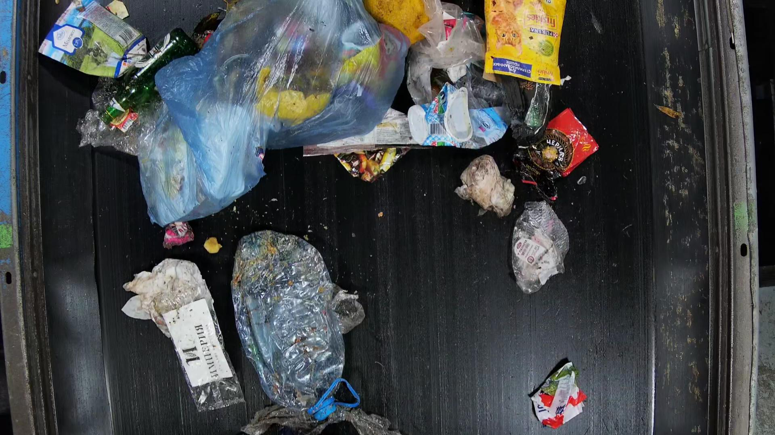

Object Detection: Teach AI in More Real-life Environment
Classification helps AI learn in a controlled environment, while Object Detection will be more practical learning.

Slide 5
Object Detection: Teach AI in More Real-life Environment
Classification helps AI learn in a controlled environment
Detection helps AI learn in a less-controlled environment
No blurry images
Assure one single object per image
Complete Object
Relatively clear background
No blurry images
OK to have Multiple objects (Avoid too many)
Ok to have partial Object only if Major features exists
Relatively clear background

Slide 6
Let’s Start Annotating New Batch for AI Grade 2!!
Notes:
https://www.youtube.com/watch?v=2hXG8v8p0KM

Slide 7
Contact: Du Pengfei
du_pengfei@SIMTech.a-star.edu.sg

Slide 8
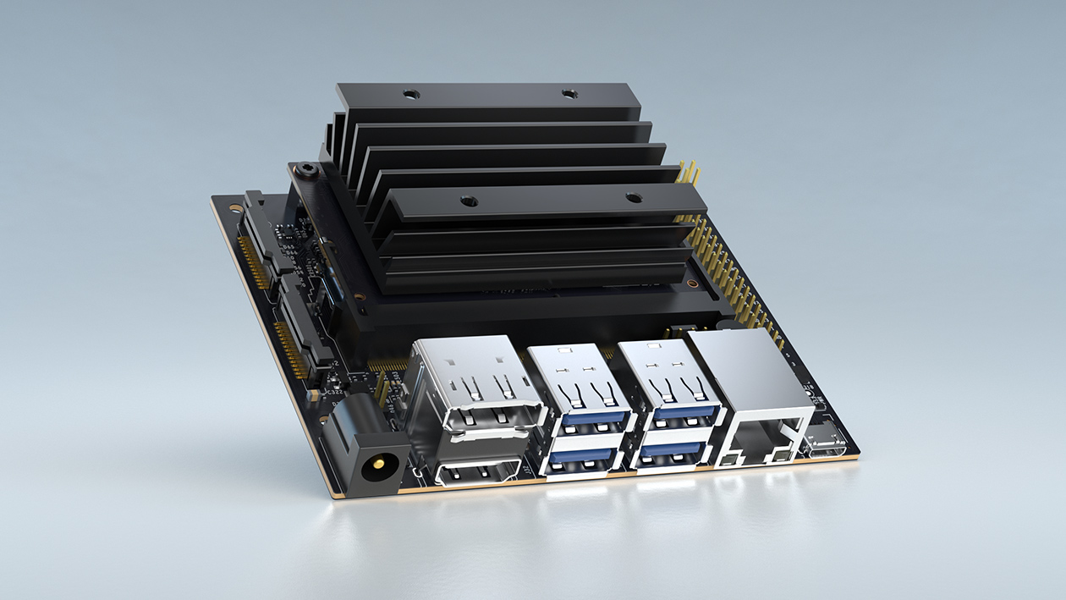
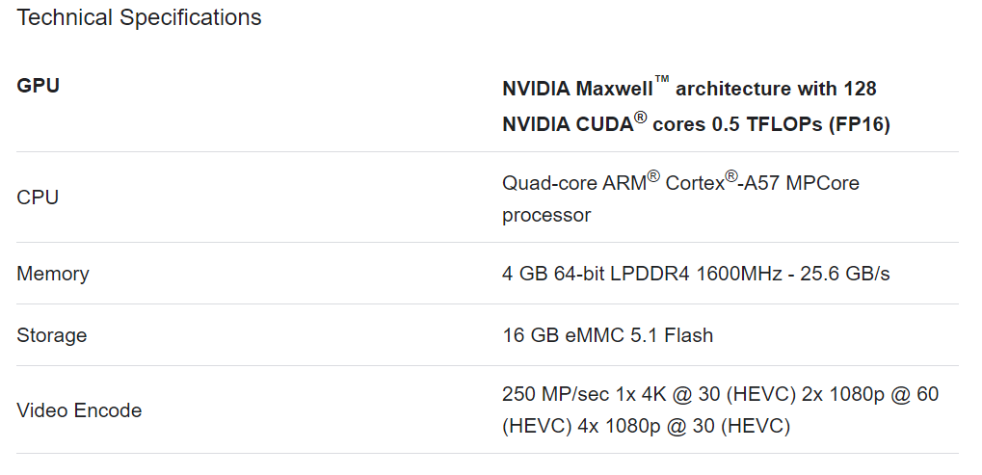
Extension: Meet our Student: AI computers
Notes:
https://www.youtube.com/watch?v=2hXG8v8p0KM

Slide 9
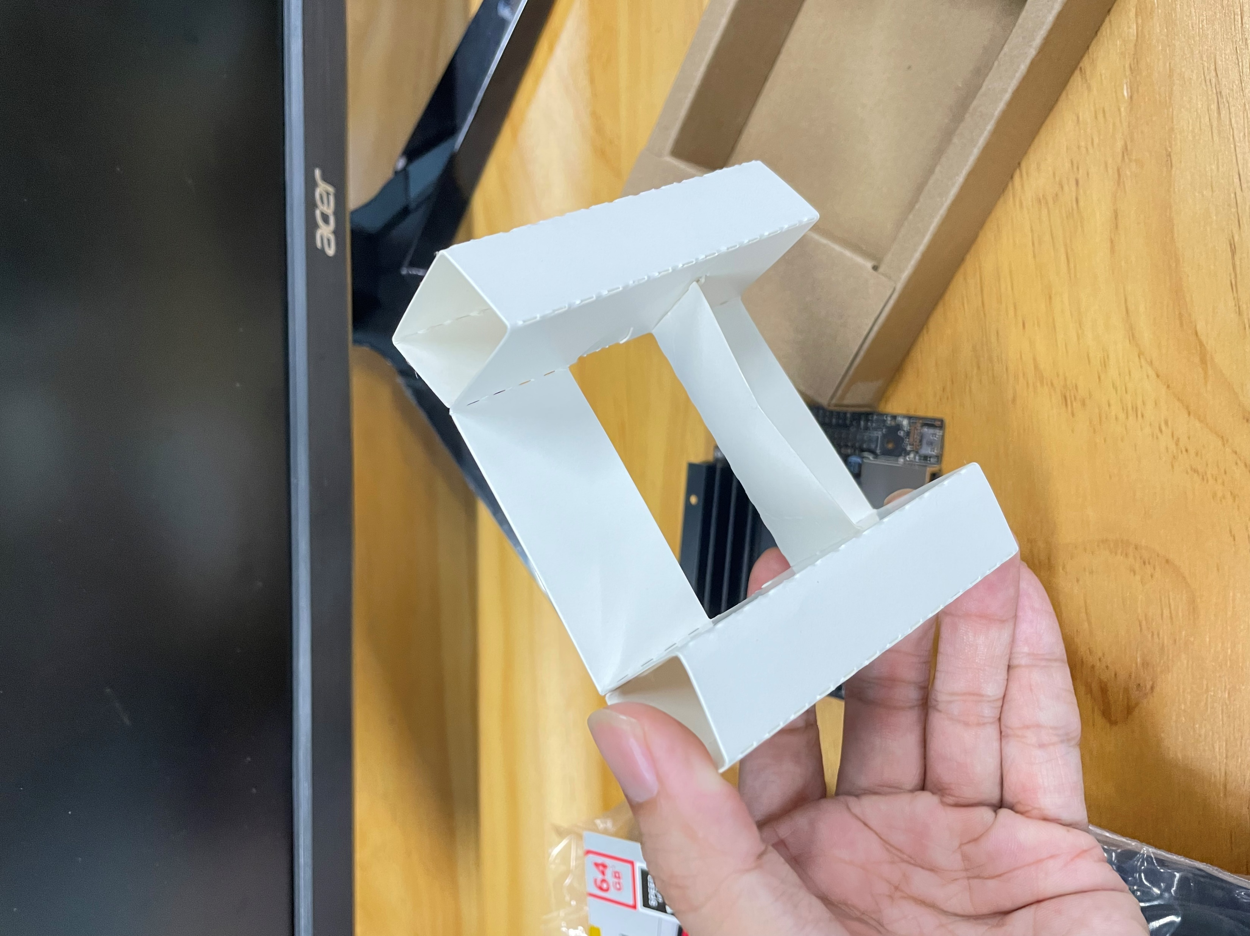
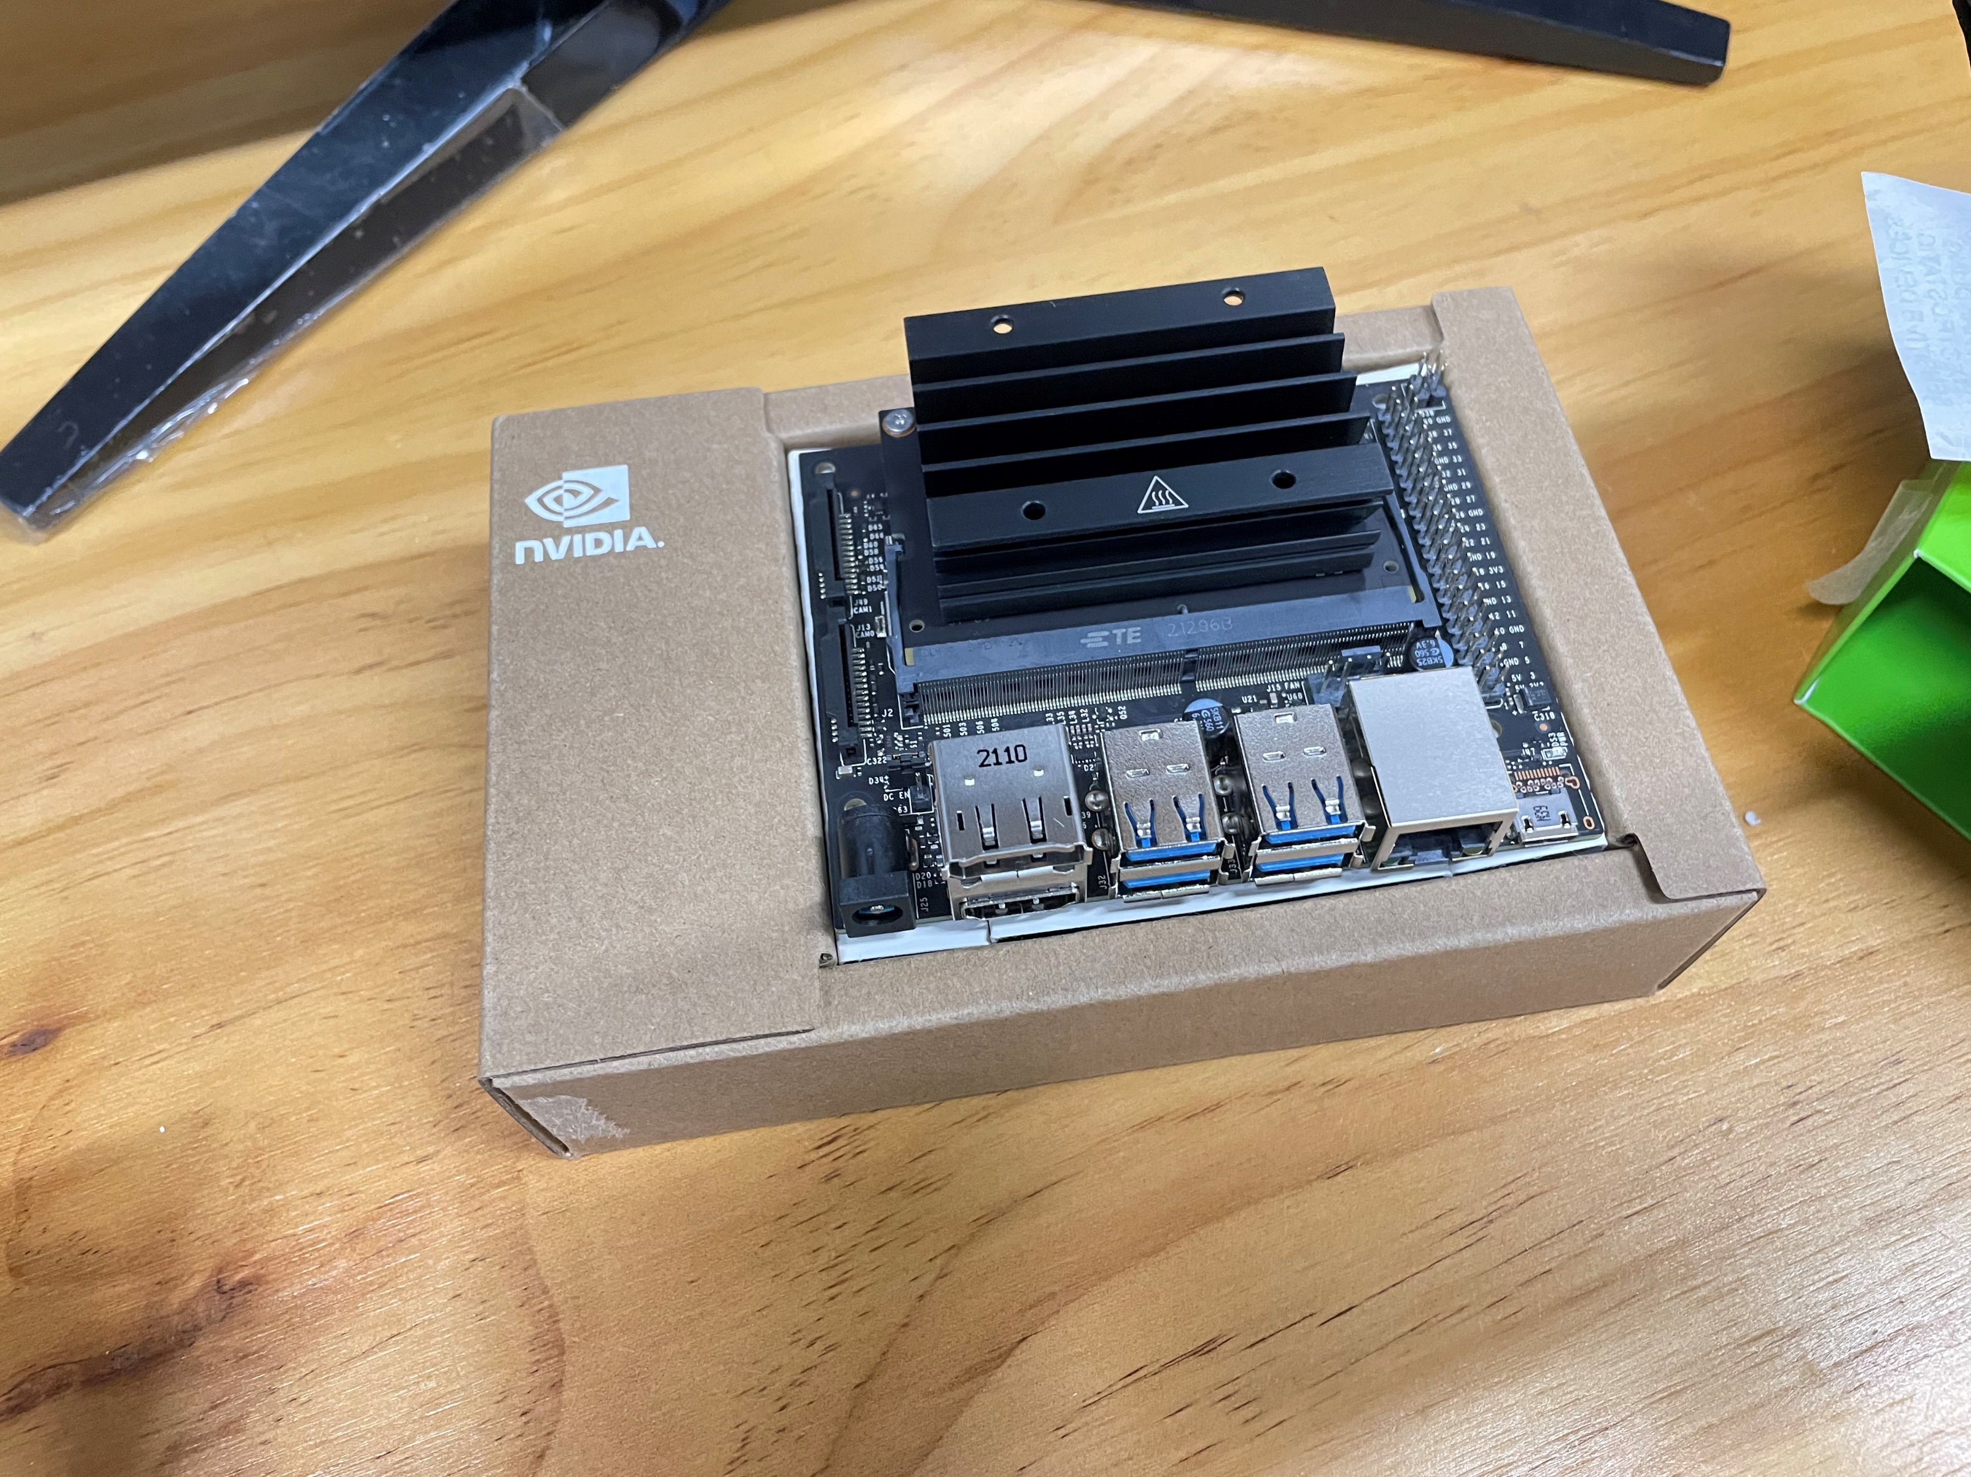
Extension: Meet our Student: AI computers
Notes:
https://www.youtube.com/watch?v=2hXG8v8p0KM

Slide 10
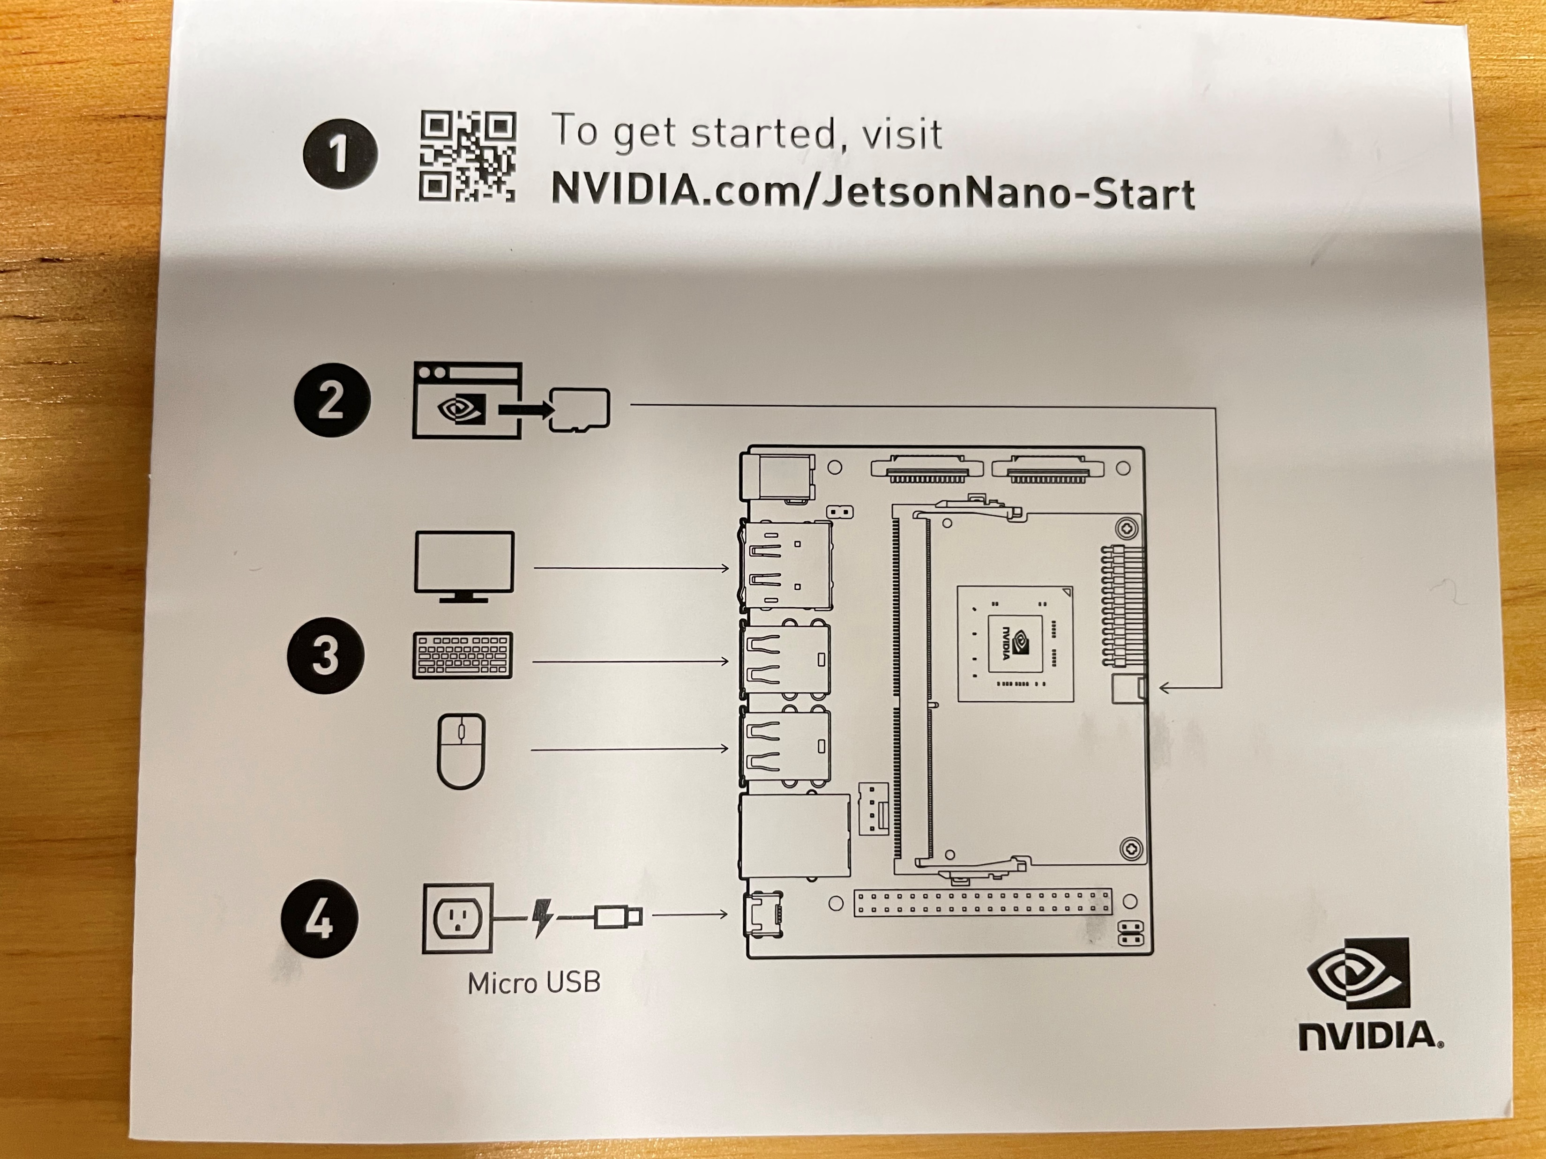
Extension: Meet our Student: AI computers
POWER ON
Notes:
https://www.youtube.com/watch?v=2hXG8v8p0KM

Slide 11
Extension: Meet out Student: AI computers
10 Line of Codes to Run Our Detection Module
Notes:
https://www.youtube.com/watch?v=2hXG8v8p0KM

